Slide 1








Integration Architecture – API Led View
Public Consumer
Public Consumer
Private
Internal Consumer
User
User
SPA
LVCOM/SPA
Secure with
ClientID Enfoncement Policy
Oauth Policy
Experience
APIs
e-zrh-quotations-issue
Publish to MQ
Anypoint Mq
Subscribe to MQ
Process
APIs
p-zrh-policy-plan
p-zrh-policy-issuance
System &
Proxy APIs
s-zrh-policy-issuance
Internal Applications
External Applications / Partners
MAINFRAME
Notes:
SPA (Single Page Application)
e- epai
p- papi
s- sapi
b- batch
a- app
Q-Configuration:
Queue_Name: q.zrh.policy.issuance.v1
Queue_Type: FIFO Queue
DLQ Name: dlq.zrh.policy.issuance.v1
Message TTL: 7 days
Acknowledgment Timeout: 60 seconds
Encryption: true

Slide 2
QUOTATION FLOW
Public Consumer
Public Consumer
Private
Internal Consumer
User
User
SPA
LVCOM/SPA
POST /api/v1/quotations
GET /api/v1/ quotations/{qId}
Exposed to the travel Booking Provider
Experience
APIs
e-zrh-quotations-issue
POST /api/v1/quotations
GET /api/v1/ quotations/{qId}
Transform the payload as per the system
Process
APIs
p-zrh-policy-plan
POST /api/v1/quotations
GET /api/v1/ quotations/{qId}
Unlock the system data
System &
Proxy APIs
s-zrh-policy-issuance
Internal Applications
External Applications / Partners
MAINFRAME

Slide 3
API’s Info
Experience API (e-zrh-quotations-issue)
Experience api created for exposing the quotations and policy issuances
RAML based API with below end points
POST /quotations - this end point is used for getting the quotations based on travelers info
GET /quotations/{qId} - this end point is used for getting the quotations based on quotations ID
POST /polices/{qId} - this end point is used for creating the policy based on travelers info - Used to publish message to Q
GET /polices/{qId} - this end point is used for getting the policy issued for travelers
GET /ping - this end point is used for health check
Process API (p-zrh-policy-plan)
Process api to transform and orchestrate data with system api
RAML based API with below end points
POST /quotations - this end point is used for getting the quotations based on travelers info
GET /quotations/{qId} - this end point is used for getting the quotations based on quotations ID
GET /ping - this end point is used for health check

Slide 4
API’s Info
Process API (p-zrh-policy-issuance)
Process api to transform and orchestrate data with system api
RAML based API with below end points
GET /polices /{pId} - this end point is used for getting the policy info issued based on policyID
GET /ping - this end point is used for health check
Have a AMQ Subscriber flow for creating/Issuing policy
System API (s-zrh-policy-issuance)
System api to unlock core system operations
RAML based API with below end points
POST /quotations - getting the quotations based on travelers info from Mainframe system
GET /quotations/{qId} - getting the quotation info based on quotationId
POST /polices/{qId} - creating the policy based on travelers info with quotationId
GET /polices/{pId} - getting the policy info issued based on policyID
GET /ping - this end point is used for health check

Slide 5
SECURITY
Client ID Enforcement policy will be applied on all the apis
Rate limiting policy will be applied on the endpoints exposed by experience-api API to protect it from unwarranted flooding of requests.
JSON Threat Protection policy will be applied on the endpoints exposed by experience-api API to protect it from malformed requests.
OAuth will be applied on the endpoints exposed by experience-api API authorize the valid clients

Slide 6
Request
{
"travellersDetails": [
{
"firstName": "sivakumar",
"lastName": "yenugu",
"dateOfBirth": "12-12-1989",
"emailId": "test123@hotmail.com",
"travelDate": "23-03-2022",
"source": "India",
"destination": "Singapore",
"returnDate": "28-03-2022"
},
{
"firstName": "sindhu",
"lastName": "yenugu",
"dateOfBirth": "12-12-1995",
"emailId": "test1234@hotmail.com",
"travelDate": "23-03-2022",
"source": "India",
"destination": "Singapore",
"returnDate": "28-03-2022"
},
{
"firstName": "jignna",
"lastName": "yenugu",
"dateOfBirth": "12-12-2017",
"emailId": "test12345@hotmail.com",
"travelDate": "23-03-2022",
"source": "India",
"destination": "Singapore",
"returnDate": "28-03-2022"
}
]
}

Slide 7
Response
{
"id": "PQ0753",
"shortDescription": "Insurance quotes",
"policyPlanData": [
{
"T1220222343": [
{
"planName": "goldTravel",
"premium": "40.1",
"currency": "SGD"
},
{
"planName": "travelEasy",
"premium": "20.1",
"currency": "SGD"
},
{
"planName": "assistanceTravel",
"premium": "10.1",
"currency": "SGD"
}
]
},
{
"T1220222344": [
{
"planName": "goldTravel",
"premium": "40.1",
"currency": "SGD"
},
{
"planName": "travelEasy",
"premium": "20.1",
"currency": "SGD"
},
{
"planName": "assistanceTravel",
"premium": "10.1",
"currency": "SGD"
}
]
},
{
"T1220222345": [
{
"planName": "goldTodTravel",
"premium": "30.1",
"currency": "SGD"
},
{
"planName": "travelTodEasy",
"premium": "20.1",
"currency": "SGD"
},
{
"planName": "assistanceChildTravel",
"premium": "5.1",
"currency": "SGD"
}
]
}
]
}

Slide 8


Design pattern used
Quotation Flow - Sync pattern

Slide 9
Policy Issuance - FLOW
Public Consumer
Public Consumer
Private
Internal Consumer
User
User
SPA
LVCOM/SPA
Exp API Exposed to the travel Booking Provider
POST /api/v1/polices/{qId}
GET /api/v1/polices /{pId}
Experience
APIs
e-zrh-quotations-issue
Publish to Q
Anypoint Mq
Transform the payload as per the system
Subscribe to Q
Process
APIs
GET /api/v1/polices /{pId}
Publish to DLQ
p-zrh-policy-issuance
POST /api/v1/polices/{qId}
GET /api/v1/polices /{pId}
System &
Proxy APIs
s-zrh-policy-issuance
Internal Applications
External Applications / Partners
MAINFRAME

Slide 10
Policy Issuance – CIRCUIT BREAKER
Public Consumer
Public Consumer
Private
Internal Consumer
User
User
SPA
LVCOM/SPA
POST /api/v1/polices/{qId}
GET /api/v1/ polices /{pId}
Experience
APIs
e-zrh-quotations-issue
Publish to Q
Anypoint Mq
Transform the payload as per the system
Subscribe to Q
CONNECTIVTY ERROR
SYSTEM API NOT REACHABLE
OPEN THE CIRCUIT BREAKER
Process
APIs
p-zrh-policy-issuance
POST /api/v1/polices/{qId}
GET /api/v1/ polices /{pId}
System &
Proxy APIs
s-zrh-policy-issuance
Internal Applications
External Applications / Partners
MAINFRAME

Slide 11
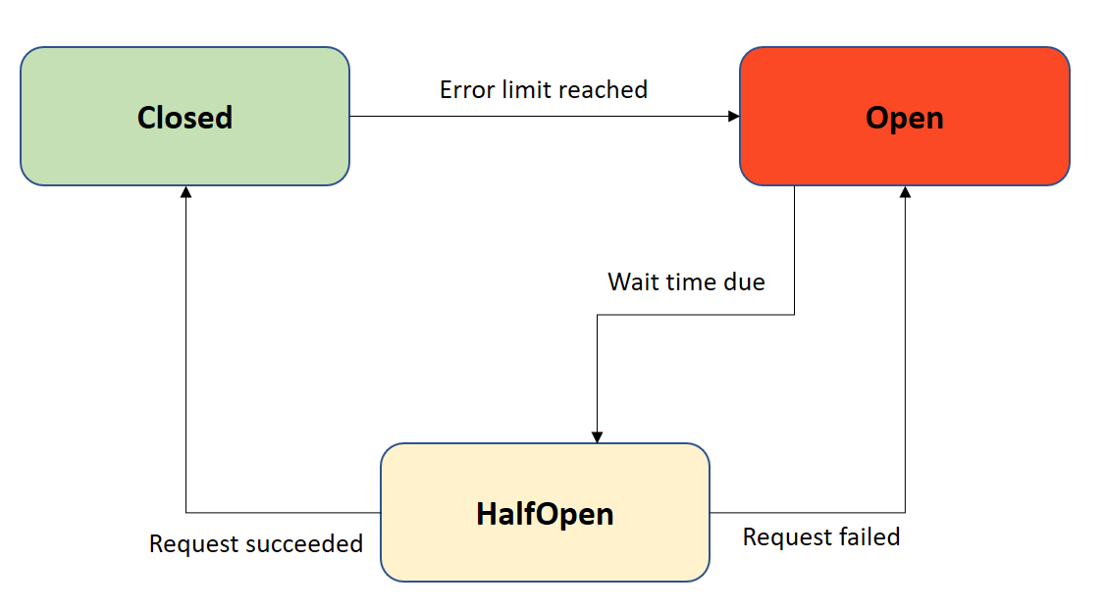
Design pattern used
POLICY ISSUANCE – Circuit Breaker pattern/ Reliability Pattern
Circuit Breaker:
Circuit breaker will be configured on the Anypoint MQ subscriber to open the circuit when there is an issue while connecting with System API or MAINFRAME from System API.
This circuit breaker configuration will have error codes related to only connectivity issues.

Slide 12
CONFIGURATION AND PROPERTIES
All parameters should be externalized and set up in the property file for each environment.
Properties that are not specific to any environment should be part of shared properties file.
All the confidential values that are stored in properties should be encrypted.
The encryption key must not be part of the source code.
Following configuration details to be maintained in the property files.
HTTP listener configuration.
HTTP requester configurations for calling internal and external apis
HTTP Requester :
Retry mechanism to be implemented and externalized with 3 times with frequency 2000/3000 ms

Slide 13
ERROR HANDLING & LOGGING
In the case of 4XX, error message will be returned to API consumer, and the interaction will be considered as “complete” from API perspective. It will be the responsibility of the API consumer to submit a new request and include the correct data fields, headers etc.
In the case of 5XX errors (except 500), the source system will have to handle these types of errors and alert the required stakeholders as these will not register with the server.
In case of error at mainframe system like connectivity we are handling with circuit breaker if other cases we need to either do add monitoring or altering mechanism for customer Reponses
In case of queue issues or queue is not accepting or queue error there should be alerting or monitoring utility
Use logging in debug mode if logging any payloads

Slide 14
ERROR HANDLING & LOGGING
Client-side errors (4XX) | Server-side errors (5XX)
400 - Bad Request 401 - Authentication Issue 404 - Resource Not Found. 405 - Method Not Allowed 406 - Not acceptable 415 - Unsupported Media Type 429 - To Many Requests Received | 500 - Internal Server Error. 502 - Bad Gateway 503 - Service Unavailable 504 - Gateway Timeout

Slide 15
API Version/Breaking changes
Code Implementation:
We will use GIT to track and monitor any change in Code implementation level for all the changes as follows
Feature Changes - feature branch
Dev Environment - dev branch
Testing - Test Environment/QA Branch with tag created from dev branch
Production issue/Hot fixes - will do in hot-fix-branch
Production Deployment - master branch
Api Specification:
For any Major changes and to support backward compatibility - maintain the versions in raml and accordingly in api (http-listener i.e like /api/v1, /api/v2)
For any Minor changes we will use the RAML version i.e 1.0.1-> 1.0.2-> 1.0.3 etc.
Api Manager/Exchange Documentation:
If two versions of the api to be maintained then we need to create two api managers for respective apis and update the api versions accordingly
Update the Exchange Documentation respectively for the versions to have latest info like api-led, environments, security, non-functional requirements etc

